Slide 1
Lecture note for Traffic Assignment
At Advanced Transportation Planning
“Traffic assignment” is the method to calibrate traffic volume on road network. The key issues are as follows:
1)Traffic congestion → Relationship between traffic volume and travel time → Part I Theory of Traffic Flow
2)Network equilibrium → How to calibrate traffic volume on each link Part II Wardrop principles

Slide 2
Part I Theory of Traffic Flow
We assume the ideal traffic flow as follows: “No traffic jams”, “No acceleration”, “No curves”
This traffic flow is “constant flow”（定常流）
There are three variables to illustrate this flow
Traffic volume Q [vehicle/hour]
Velocity V [km/hour]
Density K [vehicle/km]

Slide 3
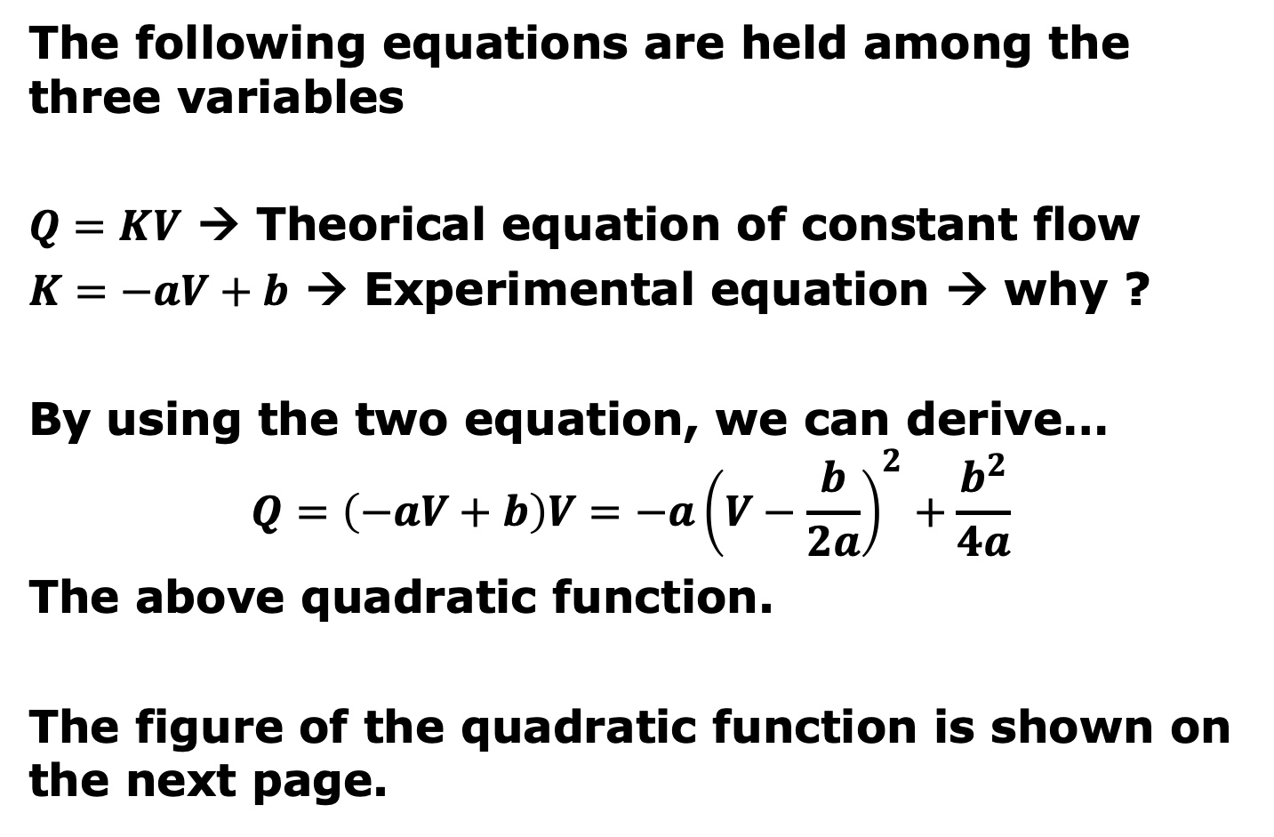
Part I Theory of Traffic Flow
The following equations are held among the three variables
$Q=KV$ → Theorical equation of constant flow
$K=−aV+b$ → Experimental equation → why ?
By using the two equation, we can derive…
$$Q=\left(−aV+b\right)V=−a{\left(V−\frac{b}{2a}\right)}^{2}+\frac{b^{2}}{4a}$$
The above quadratic function.
The figure of the quadratic function is shown on the next page.

Slide 4
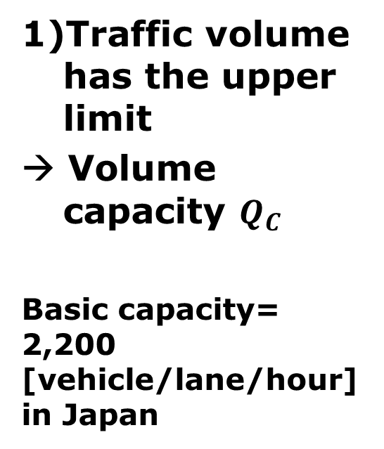
Part I Theory of Traffic Flow
This figure is called “QV function”
1)Traffic volume has the upper limit
→ Volume capacity $Q_{C}$
Basic capacity= 2,200 [vehicle/lane/hour] in Japan
[km/hour]
[vehicle/hour]

Slide 5
Part I Theory of Traffic Flow
This figure is called “QV function”
2)Any “Q” has two velocities
“Two-value problem”
A volume has “Free flow velocity” & “Congestion flow velocity”
[km/hour]
[vehicle/hour]

Slide 6
Part I Theory of Traffic Flow
This figure is called “QV function”
Upper area is “Free flow area”
（自由走行領域）
Lower area is “Congestion flow area”
（渋滞領域）
[km/hour]
[vehicle/hour]

Slide 7
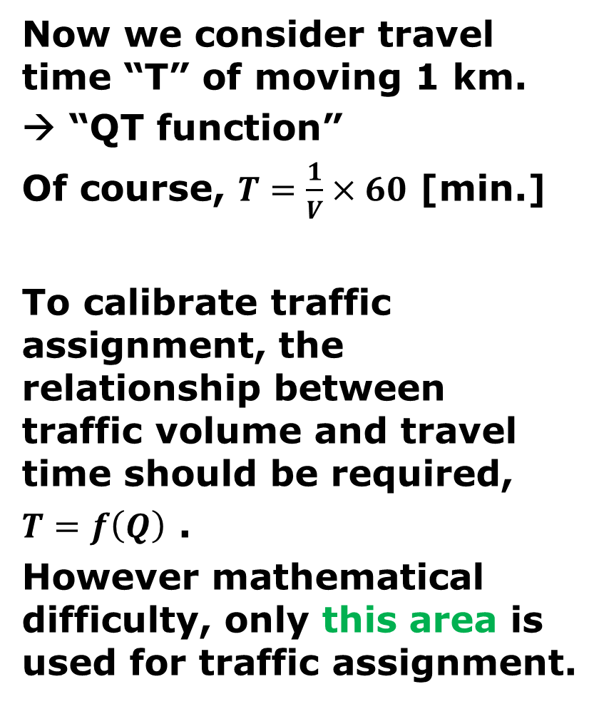
Part I Theory of Traffic Flow
Now we consider travel time “T” of moving 1 km.
→ “QT function”
Of course, $T=\frac{1}{V}×60$ [min.]
To calibrate traffic assignment, the relationship between traffic volume and travel time should be required,
$T=f\left(Q\right)$ .
However mathematical difficulty, only this area is used for traffic assignment.
[minutes]
[vehicle/hour]
[vehicle/hour]
[vehicle/hour]

Slide 8
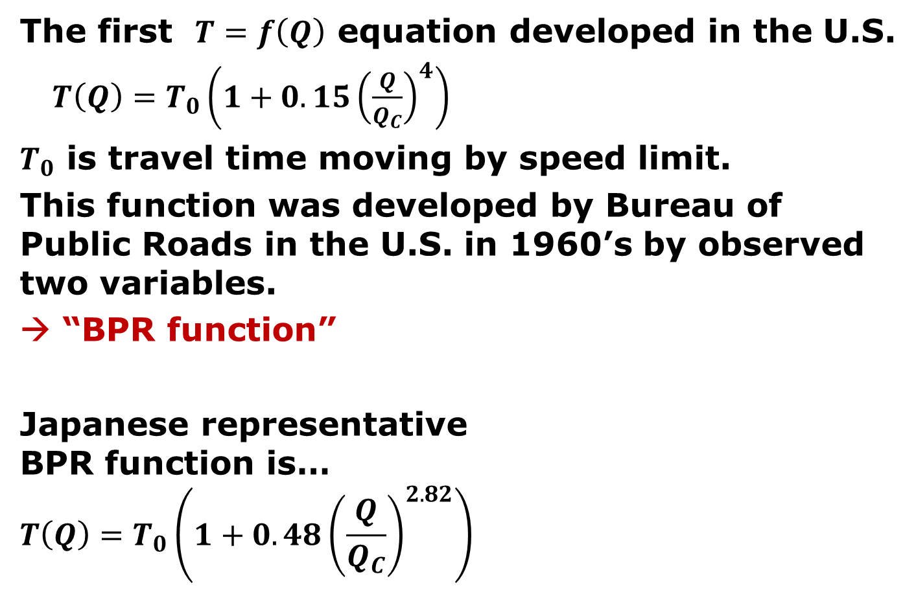
Part I Theory of Traffic Flow
The first $T=f\left(Q\right)$ equation developed in the U.S.
$T\left(Q\right)=T_{0}\left(1+0.15{\left(\frac{Q}{Q_{C}}\right)}^{4}\right)$
$T_{0}$ is travel time moving by speed limit.
This function was developed by Bureau of Public Roads in the U.S. in 1960’s by observed two variables.
→ “BPR function”
Japanese representative BPR function is…
$$T\left(Q\right)=T_{0}\left(1+0.48{\left(\frac{Q}{Q_{C}}\right)}^{2.82}\right)$$
[minutes]
[vehicle/hour]

Slide 9
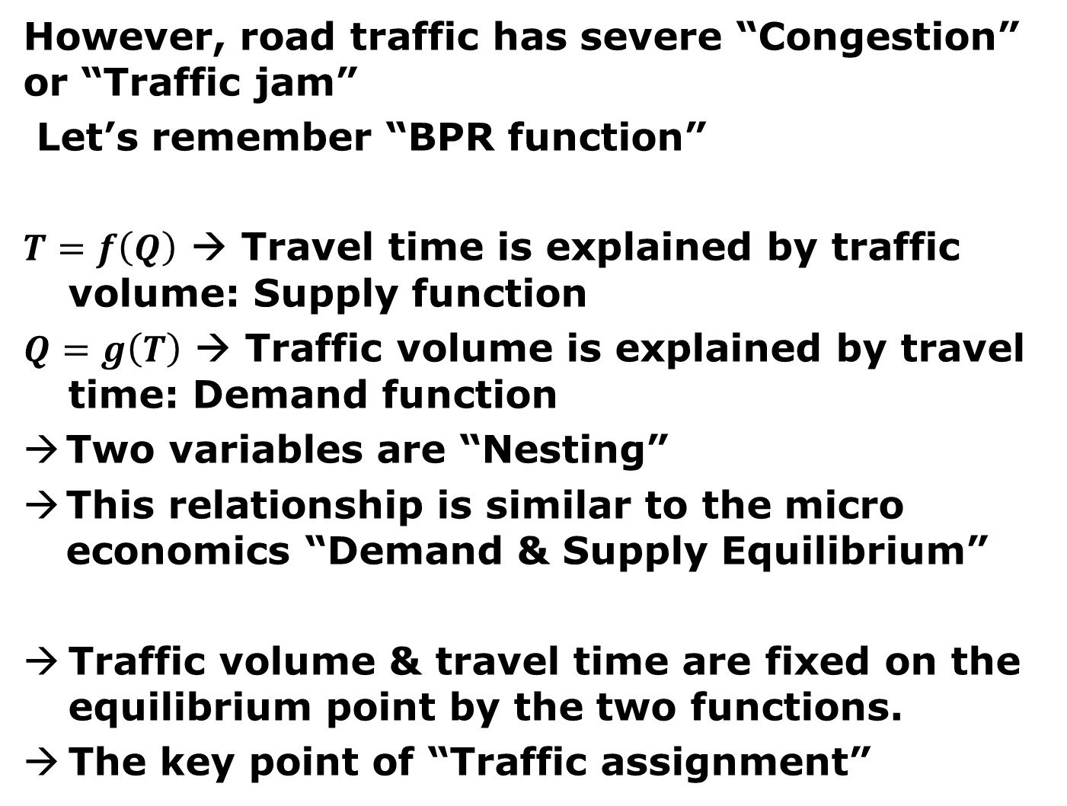
However, road traffic has severe “Congestion” or “Traffic jam”
Let’s remember “BPR function”
$T=f\left(Q\right)$ → Travel time is explained by traffic volume: Supply function
$Q=g\left(T\right)$ → Traffic volume is explained by travel time: Demand function
Two variables are “Nesting”
This relationship is similar to the micro economics “Demand & Supply Equilibrium”
Traffic volume & travel time are fixed on the equilibrium point by the two functions.
The key point of “Traffic assignment”

Slide 10
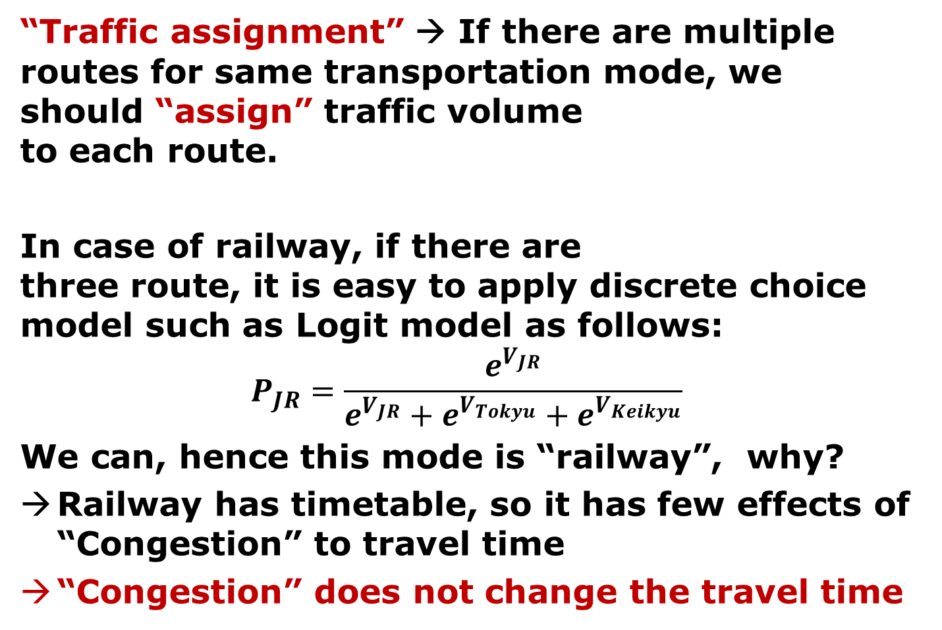
Here after “Part II Wardrop principles”
“Traffic assignment” → If there are multiple routes for same transportation mode, we should “assign” traffic volume to each route.
In case of railway, if there are three route, it is easy to apply discrete choice model such as Logit model as follows:
$$P_{JR}=\frac{e^{V_{JR}}}{e^{V_{JR}}+e^{V_{Tokyu}}+e^{V_{Keikyu}}}$$
We can, hence this mode is “railway”, why?
Railway has timetable, so it has few effects of “Congestion” to travel time
“Congestion” does not change the travel time
JR
Tokyu
Keikyu

Slide 11




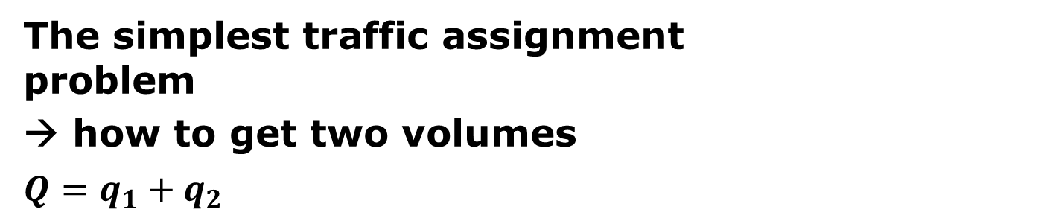


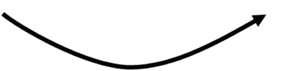



The simplest traffic assignment problem
→ how to get two volumes
$Q=q_{1}+q_{2}$
$$q_{1}$$
$$q_{2}$$
$$t_{1}$$
$$t_{2}=f\left(q_{2}\right)$$
$$t_{1}=f\left(q_{1}\right)$$
$$t_{2}$$
$$q_{1}$$
$$q_{2}$$
$${Q=q}_{1}+q_{2}$$

Slide 12
We assume “drivers choose the fastest route” → This assumption is called “User Equilibrium”
$$t_{1}$$
$$t_{2}=f\left(q_{2}\right)$$
$$t_{1}=f\left(q_{1}\right)$$
$$t_{2}$$
$$q_{1}$$
$$q_{2}$$
$${Q=q}_{1}+q_{2}$$

Slide 13
The solutions of “User Equilibrium”
“Travel time of all routes are same”
Another name, “Wardrop first principle”
In case of the right network, the number of routes from “O” to “D” is 6, but 3*3 case has 20, 4*4 case has 70…
In the real world, there are infinite routes.
So “All routes” can not be analyzed !
D
O
N☓Nのマス目の経路数は 2NCN

Slide 14
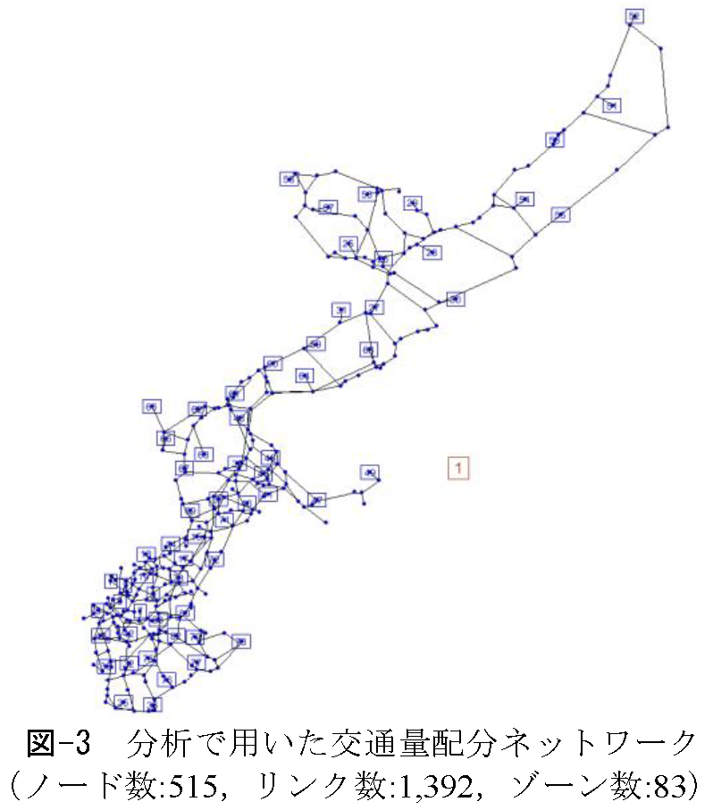
Ex) In 2012, Hyodo analyzed Okinawa island road network assignment.
The road network data had 515 nodes, 1392 links, 83 zones.
http://www2.kaiyodai.ac.jp/~hyodo/V_and_V.pdf

Slide 15
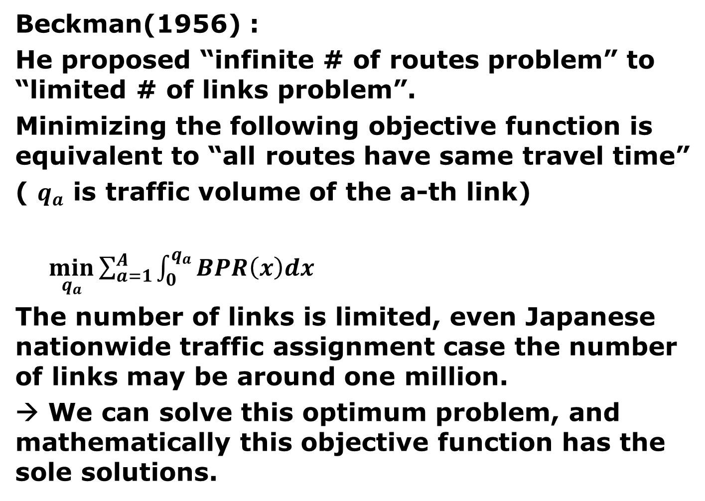
Beckman(1956) :
He proposed “infinite # of routes problem” to “limited # of links problem”.
Minimizing the following objective function is equivalent to “all routes have same travel time”
( $q_{a}$ is traffic volume of the a-th link)
$\min_{q_{a}}{\sum_{a=1}^{A}{\int_{0}^{q_{a}}{BPR\left(x\right)dx}}}$
The number of links is limited, even Japanese nationwide traffic assignment case the number of links may be around one million.
→ We can solve this optimum problem, and mathematically this objective function has the sole solutions.

Slide 16
Beckman’s integration means calculating the following yellow area (route 1) & red area (route 2).
$$t_{1}$$
$$t_{2}=f\left(q_{2}\right)$$
$$t_{1}=f\left(q_{1}\right)$$
$$t_{2}$$
$$q_{1}$$
$$q_{2}$$
$${Q=q}_{1}+q_{2}$$

Slide 17


Wardop 1st principle:
→ User Equilibrium
$$t_{1}\left(q_{1}\right)$$
$$t_{1}\left(q_{1}\right)$$
“All routes’ time are same”
→ generally, there are
unlimited number of routes
Other way to solve:
Beckman equation
It can convert unlimited “routes problem” to limited “link problem”

Slide 18
Hotelling Ice cream shops problem (1929)
Wardop 2nd principle:
→ System Optimum
A
B
A
B
A
B
Minimizing “Total time”
→ Maximize Social Welfare
However, solutions of Wardrop 1st and 2nd are generally different
→ We can not realize “social” optimum by User Equilibrium

Slide 19
What’s the differences between 1st and 2nd ?

Slide 21
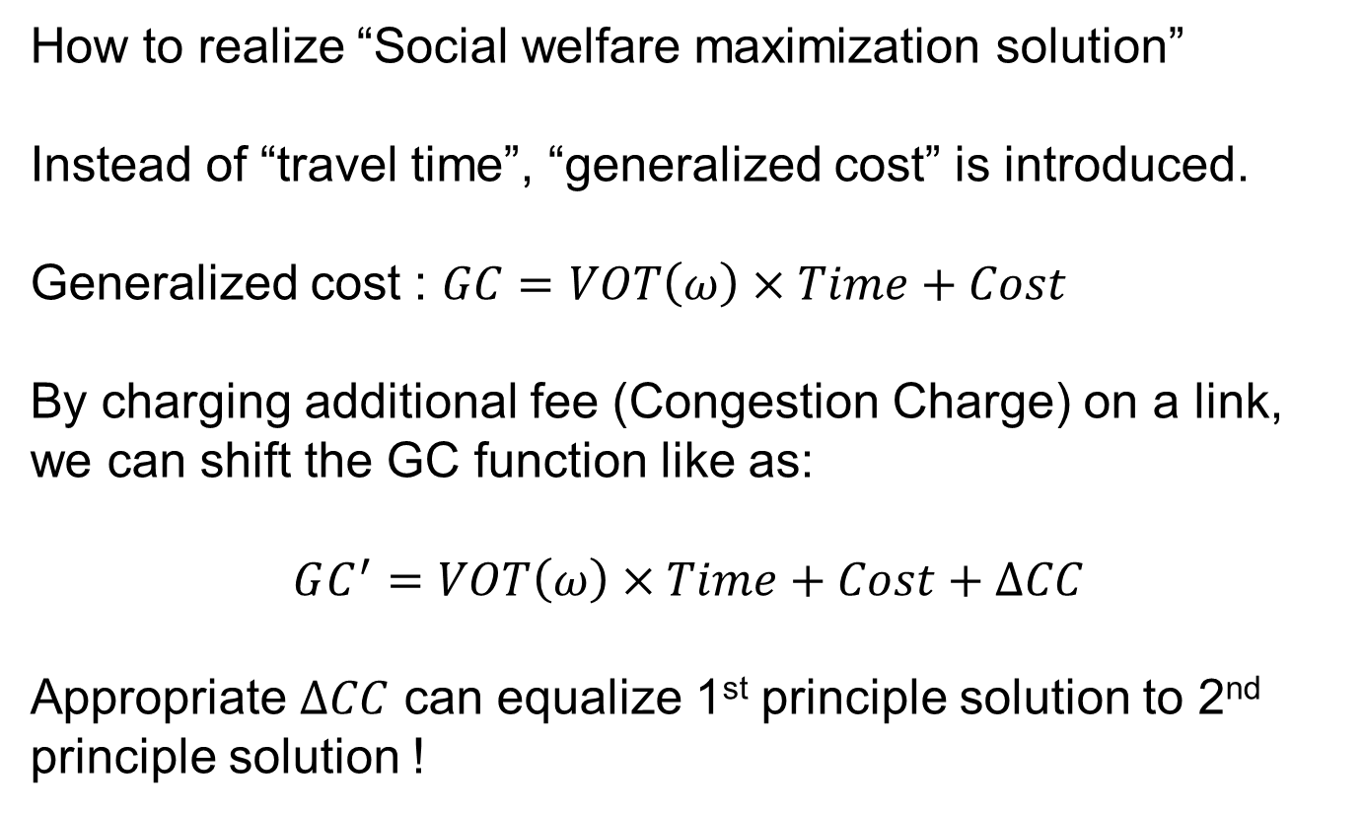
How to realize “Social welfare maximization solution”
Instead of “travel time”, “generalized cost” is introduced.
Generalized cost : $GC=VOT\left(ω\right)×Time+Cost$
By charging additional fee (Congestion Charge) on a link, we can shift the GC function like as:
$$GC^{′}=VOT\left(ω\right)×Time+Cost+∆CC$$
Appropriate $∆CC$ can equalize 1st principle solution to 2nd principle solution !

Slide 22
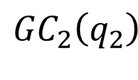
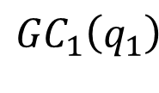

$${GC}_{1}\left(q_{1}\right)$$
$${GC}_{2}\left(q_{2}\right)$$
$∆CC$

Slide 23
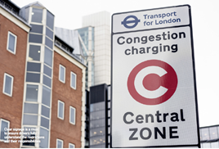
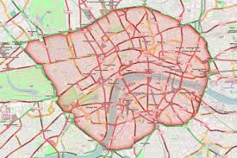
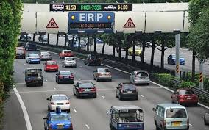
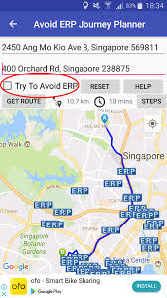
“Congestion Charge” in London
Electronic Road Pricing in Singapore

Slide 24
Home Work:

Slide 25
Q1: Under the assumption of Wardrop 1st principle (User Equilibrium), calculate the following values:
1) traffic volume of each route
2) travel time and generalized cost of each route
3) total generalized cost
Q2: Under the assumption of Wardrop 2nd principle (System Optimum), calculate the following values:
1) traffic volume of each route
2) travel time and generalized cost of each route
3) total generalized cost
Q3: To maximize social welfare, the toll of route-2 will be appropriately increased. Please calculate:
1) increased price (difference)
2) total generalized cost
3) increased toll revenue
Deadline: August 26th Wed.

